Slide 1
Embedded System Design
LIAO Yong

Slide 2
Chapter 5 Software Design of ESS

Slide 3
1 Overview
How to embark on designing and analyzing a ESS (Embedded Software System) ?
DARTS(Design Algorithm for Real Time Systems)
UML (Unified Modeling Language)

Slide 4
2 How to embark on designing and analyzing a ESS ?
Problems appeared in the system design
    How to acquire the detailed function and performance requirements step by step?
    Does the system need a ERTOS?

Slide 5
2 How to embark on designing and analyzing a ESS ?
Problems appeared in the system design
    How to Decompose the system into concurrent tasks, according to the requirement analysis ?
    How to design the functions of each task ?
    What are the relations between tasks, how do they interact with each other to achieve a better system efficiency ?
    How to consider the performance requirements during the function analysis and design?
    How to design a large-scaled ESS ?

Slide 6
2 How to embark on designing and analyzing a ESS ?
What’s the difference between developing an application system based on ERTOS and that based on the general OS ?
    Application & Process & Module (general-OS-based)
    Application (Mission) & Task & Module (ERTOS-based)
    (1:1)
How to use the idea of Software Engineering to design a ESS ?
(1:n)

Slide 7

3 DARTS
DARTS (Design Algorithm for Real-Time Systems)
Use DARTS to Design a ESS
    Requirement analysis: State diagram
    System design
    1) Data flow diagram
    2) Task decomposition
    3) Interface definition between tasks
    Task design
    Module design
    System integration and test

Slide 8
4 UML
UML (Unified Modeling Language)
    Object-oriented design method
    Standard elements of UML
      Use case, class, state, sequence, collaboration, activity, component, deployment
    Rational Rose & Rational Rose RealTime
      Why Rational Rose RealTime ?
      Rational Rose RealTime is a complete life cycle Unified Modeling Language (UML) development environment created to meet these real-time embedded challenges. It provides a UML-compliant solution to the unique problems of concurrency and distribution

Slide 9
4 UML
UML (Unified Modeling Language)
    Rational Rose RealTime
      Rational Rose RealTime unifies the project team by providing an extensive set of tool integrations to meet the needs of the entire team, from requirements capture through high-performance code generation, testing, and debugging for RTOS targets
      A UML model compiler generates complete C, C++, and Java application for UNIX, Windows NT/2000, and RTOS targets. this automated code generation eliminates the need for manual translation and avoids costly design interpretation errors

Slide 10
4 UML
UML (Unified Modeling Language)
    Rational Rose RealTime
      Reverse engineering enables you to understand your existing systems
      Concurrency is inherent in ERTS. A best practice solution to handling concurrency is the active object design pattern. Active objects encapsulate their own execution. Since they communicate through message-based interface ports, like the pins on hardware integrated circuits, they can be flexible mapped to the tasks of RTOS. The active objects are modeled as UML-compliant capsules

Slide 11
4 UML
UML (Unified Modeling Language)
    Rational Rose RealTime
      Ports are objects whose purpose is to send and receive messages to and from capsule instances
      Protocols are used to define the messages transmitted between capsules
    How to utilize the excellent points of UML & DARTS to design an ESS?

Slide 12
5 Development tools for ESS
Classification (P92)
Cross development environment
    Host + Target + Connection
    Editor + Cross compiler (GCC) + Cross linker + Cross debugger (GDB) + Simulator + downloader… = IDE
Development process
    Analysis & Design
    Coding & Generation (P95)
    1) Coding
    2) Cross compile (GCC)
    3) Cross link

Slide 13
5 Development tools for ESS
Development process
    Cross debug (What is the cross debug special?) (P96)
    1) Crash & Burn
    2) Rom Monitor (P98)
    3) Rom Emulator
    4) ICE (In Circuit Emulator)
    5) OCD (On Chip Debugging)
    BDM (Background Debugging Mode)
    JTAG (Joint Test Access Group) (P102)
    ARM E-TRACE
    Nexus
    Solidification (What’s the difference between the debug environment & the solidification environment?)

Slide 14
6 Others
Questions ?

Slide 15
library
Source Code
Object modular
Executable
File ( .hex)
Bootrom_res.hex
Editor
Cross
Compiler
Cross
Linker

Slide 16
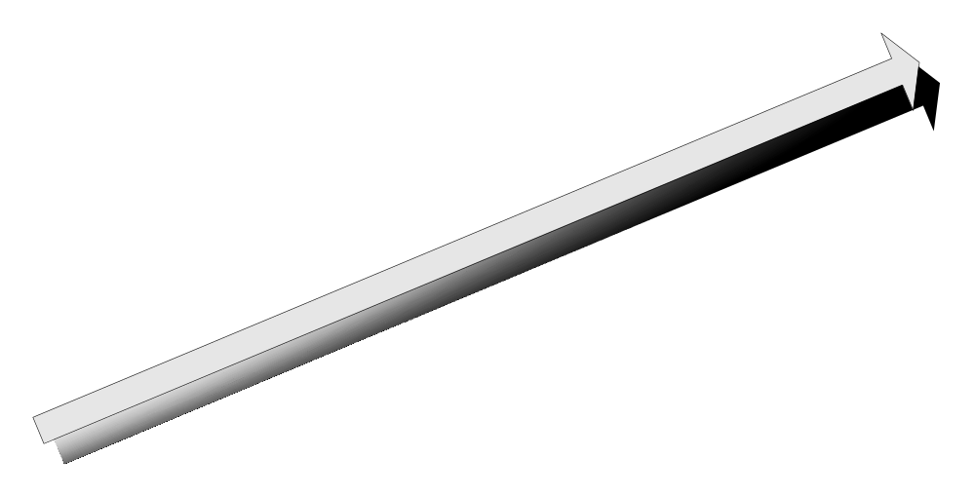
Release
Test
Coding
Software Design
Requirement Analysis

Slide 17
Rational Rose
RealTime
ObjectGeode
Rhapsody
TAU
Tornado
Lambda Tools
pRISM+
Spectra
Win CE Platform
Builder
CodeWarrior
Xray Debugger
Logiscope
CodeTEST
Phases
Requirement
Analysis
Software
Design
Coding
Test
Release

Slide 18
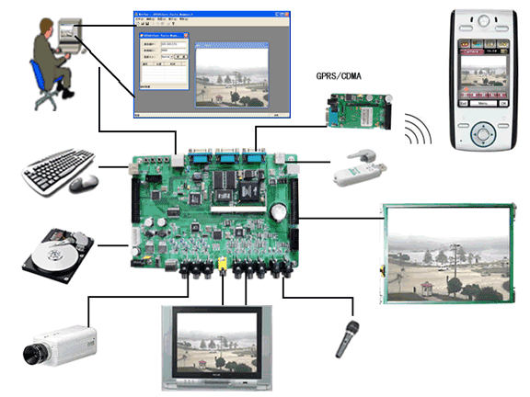

Slide 19
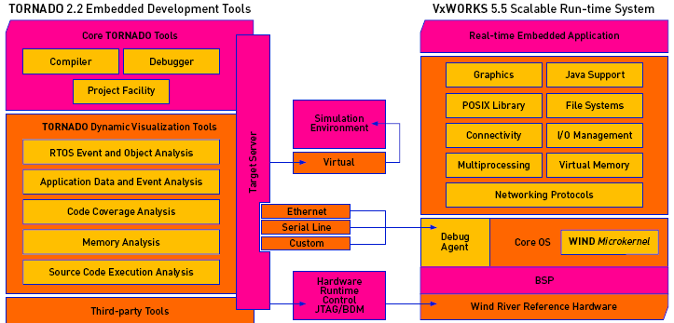
(1)
(5)
(4)
(3)
(2)

Slide 20
Wind River’s optional TORNADO tools:
    StethoScope: View an application’s data and events dynamically.
    TraceScope: Trace function execution in real time.
    MemScope: View an application’s detailed dynamic memory usage in real-time.
    ProfileScope: View a detailed function-by-function analysis that pinpoints CPU inefficiences.
    ……

Slide 21
Wind River’s optional TORNADO tools:
    WINDVIEW: The WINDVIEW diagnostic and analysis tool provides detailed visibility into application software as it runs on the actual target hardware.
    VxSIM: The VxSIM prototyping and simulation tool enables developers to create prototype applications–including networking and multi-processor-based designs–before the actual target hardware becomes available.

Slide 22
WIND MICROKERNEL： supports a full range of real-time features including fast multitasking, interrupt support, and both preemptive and round-robin scheduling. The microkernel design minimizes system overhead and enables fast, deterministic response to external events. The run-time environment also provides efficient intertask communication mechanisms.

Slide 23
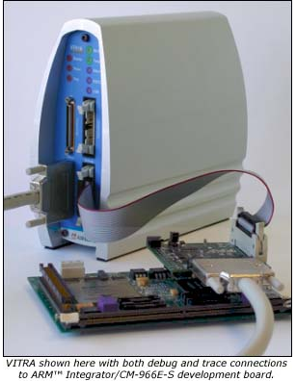
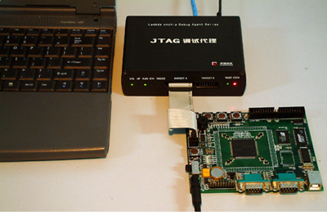

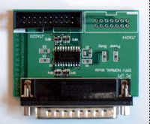


Slide 24
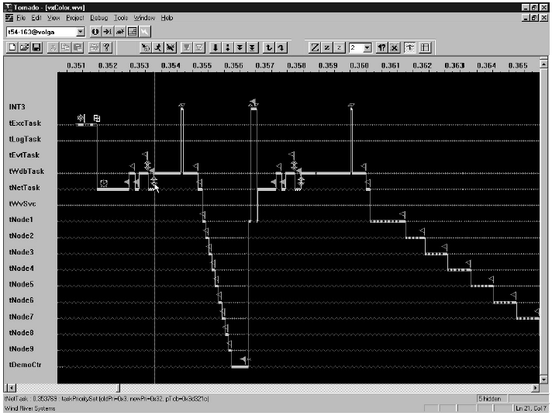

Slide 25
